Slide 1
An AI for Peshka
By Ilan Godik and Yuval Alfassi

Slide 2
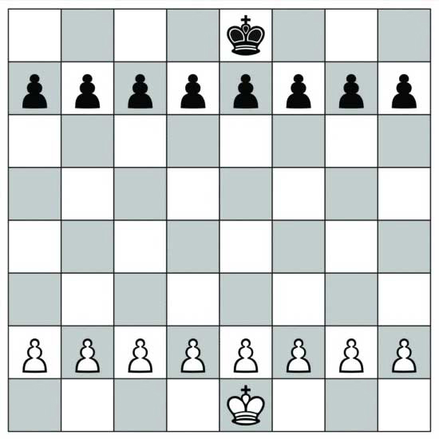
What is Peshka?
A chess game where the starting board has only the pawns and the king.

Slide 3
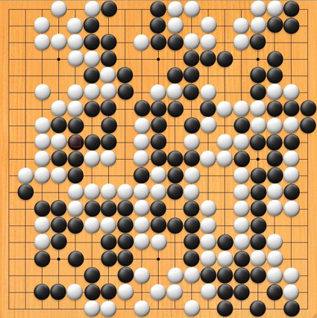
AlphaGo
Three month ago, Google Deep Mind managed to build an AI that beat the world’s best Go player
We reproduced it with Peshka

Slide 4
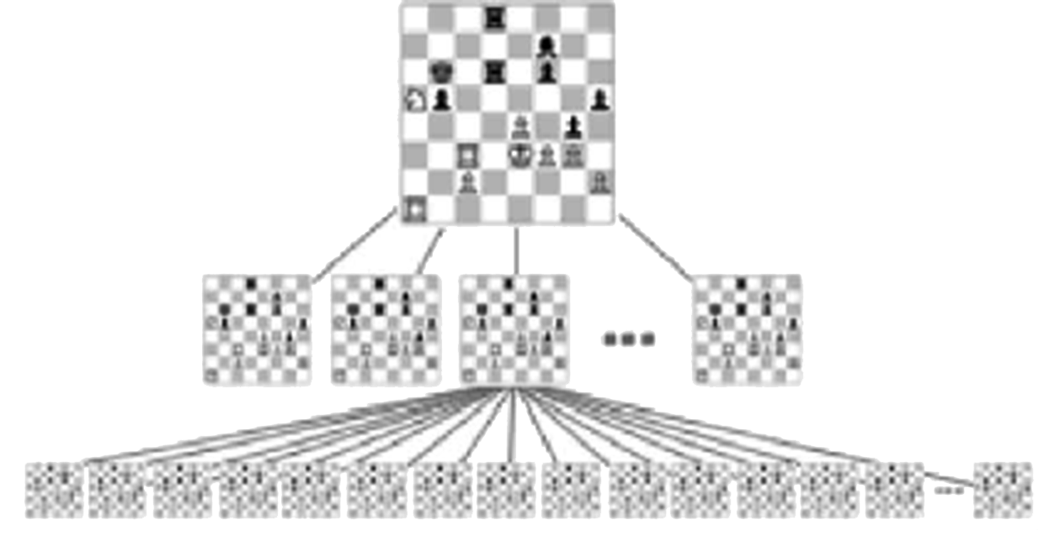
Our Peshka AI
Traditional chess AI’s use Minimax algorithm
We have designed an AI based on a guided Monte-Carlo tree search
Our AI was developed on top of the Stockfish chess engine

Slide 5
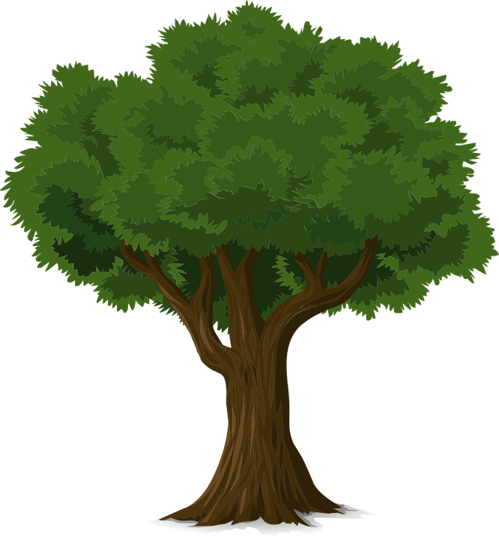
Monte-Carlo tree search
An asymmetric search tree
Game nodes store statistical data about their winning probability.
The tree will be guided using a smart heuristic function

Slide 6

Monte-Carlo tree search

Slide 7
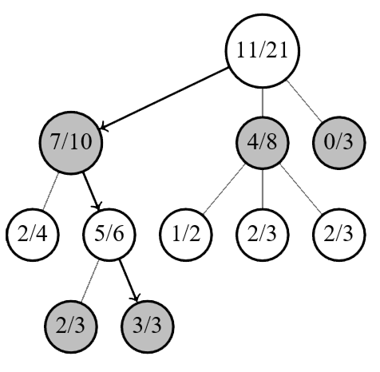
Selection
Select an Interesting leaf node

Slide 8
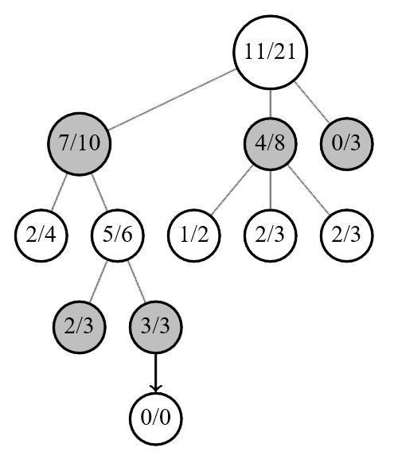
Expansion
Expand this node using smart heuristic guidance

Slide 9
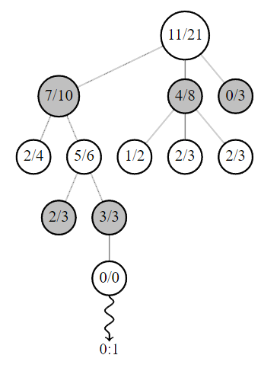
Simulation
Simulate the game until the end

Slide 10

Guided Simulations
Choose moves smartly instead of random sampling
We used Stockfish’s heuristic function
AlphaGo learned moves with Deep Learning

Slide 11
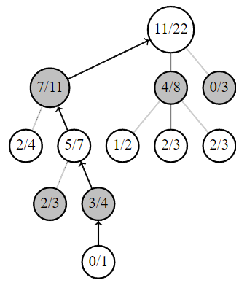
Back-Propagation
Back-propagate the result, updating game statistics

Slide 12

Thank you!

